Slide 1
Slaying a Life Optimizing GPU-accelerated Game of Life Stencil
🙋‍♂️ Matyáš Brabec
👤 Jiří Klepl
👤 Martin Kruliš

Slide 2
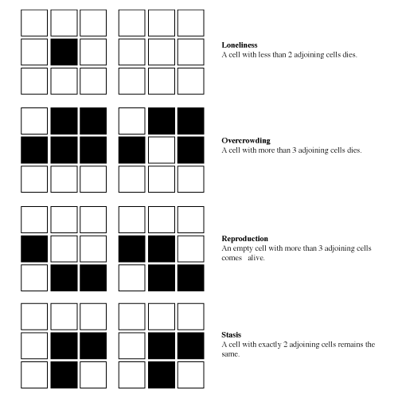
Game of life 👀
Grid
2 dimension
Cell states: DEAD ⚰️/ ALIVE 👶
Lonely
Crowded
Survives
Reproduction

Slide 3
Stencils
Iterative grid-based computation #️⃣
Each cell updated from neighbors
Algorithm (kernel) fixed for each cell
Examples 🧪
Simulations (atmosphere …)
Image processing (blur …)
Cellular automata
…

Slide 4
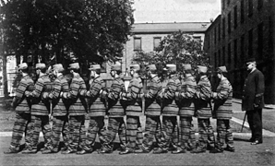
Challenges on GPU ⚠️
High memory bandwidth use
Instructions per byte ⚖️📉
Memory-bound performance 🐌
Code divergence 🔀
“if”s in the code
Stable regions 🧘
Unnecessary computation 💤❌
Unnecessary cache eviction 🧹💾
Individual threads
Warp

Slide 5
game of life rules
c ~ Current state of the cell
n ~ Number of neighbors
( )
c == 1
&&
n == 2
||
n == 3
||
c == 0
&&
n == 3
( )

Slide 6
game of life rules
= 1
n
( c | n )
000
001
010
011
100
101
110
111
1000
001
001
011
011
111
101
111
111
1001
n == 3 || ( c == 1 && n == 2 )
0011
0011
0001
0001
0001
0010
0010
Next state
is alive
|
|
0011
0011
( c | n )
→ == 3

Slide 7
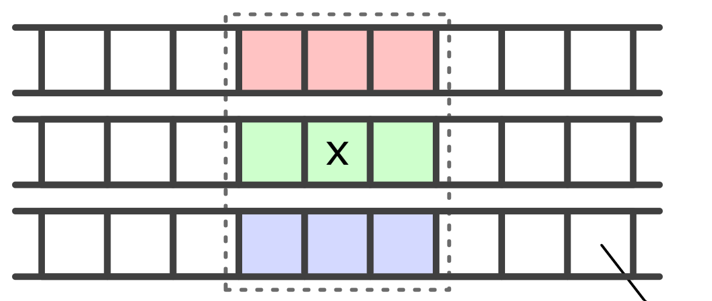
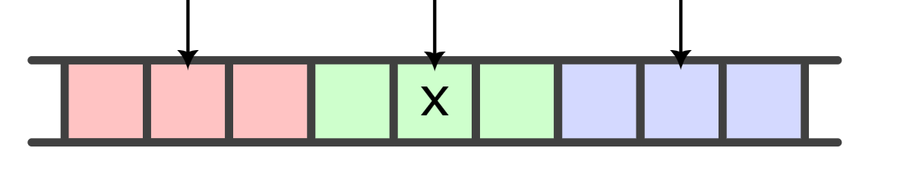
Dense memory layout (bit-packing)
Linear
64/32-bit word ~ ROW
Tiled
64/32-bit word ~ TILE
popc( )
…
popc( )
…
…
…

Slide 8
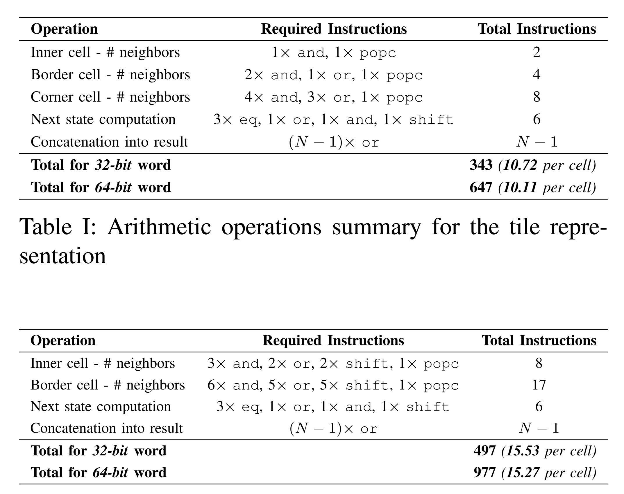
Ops per Cell 🧮
Linear 🐌
Tiled 🚀
~15 operations per cell
~10 operations per cell

Slide 9
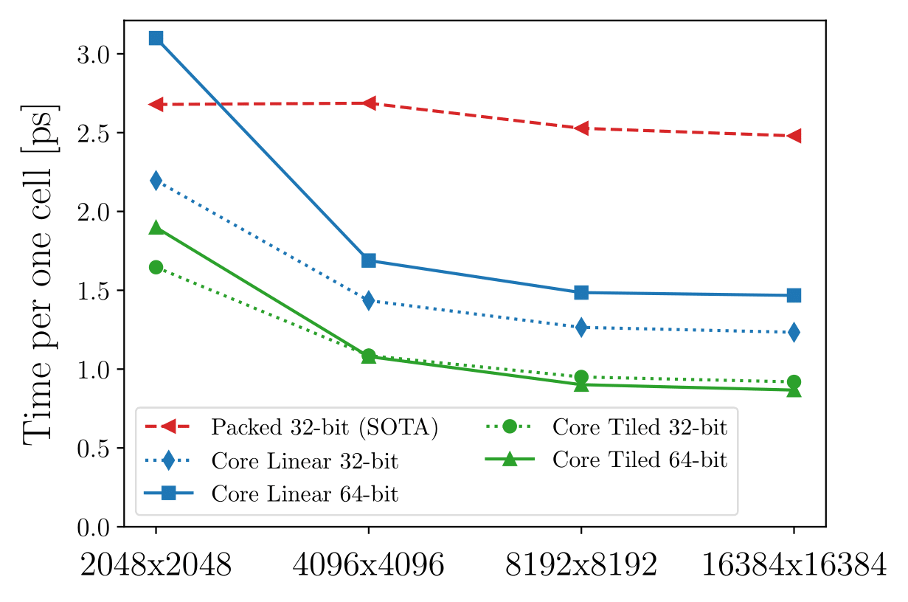
Resutls 📊
Baseline
Linear (64 b)
Linear (32 b)
Time per one cell
Tiled (32 b)
Tiled (64 b)
Grid size

Slide 10

Work reduction 💤
💡Skip stable areas
❓what are “areas”
❓how to keep track of them
❓can we skip them
Demo: https://erunno.github.io/gol-work-reduction/

Slide 11
Work reduction 💤 (on GPU)
Grid tile per thread block
🔄 “Changed” data structure
One bit per warp tile
One 32-bit word per tile
…
…
little tile per warp
…
warp tile 💤
warp tile 💤
…

Slide 12
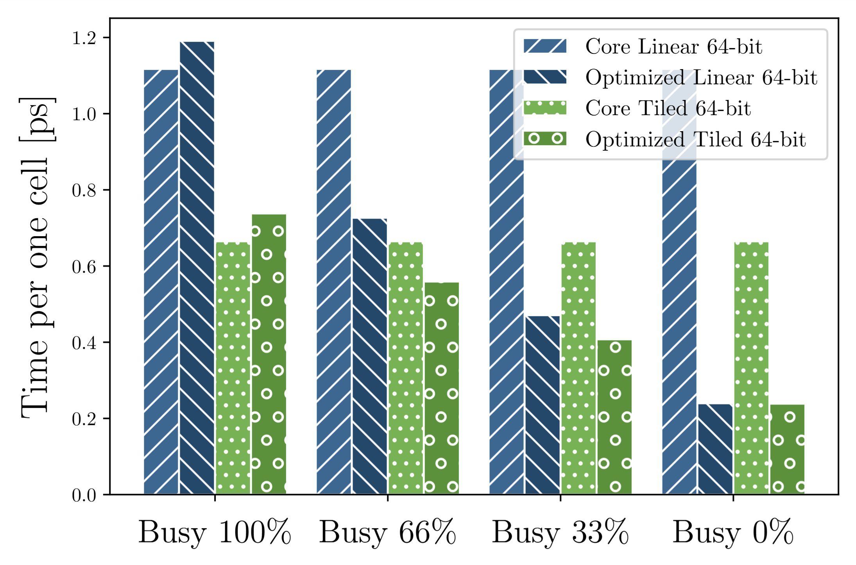
Results 📊
Linear (32 bit)
Baseline no work reduction
Work reduced
Tiled (64 bit)

Slide 13

Q&A

